Slide 1
Final Project:
Data Science Workflow:
Video Overview
Data 100/200A: Principles and Techniques of Data Science
Chrystal Chern, Ke Ma, Andrew Yeskoo
Notes:
Welcome to the video overview of our Data 100 final project: a full data science workflow using the COVID 19 dataset.

Slide 2
Data Science Workflow Final Project Video Overview
Data 100/200A: Principles and Techniques of Data Science
Chrystal Chern, Ke Ma, Andrew Yeskoo
COVID-19 Dataset
Question Framing
Static Factors vs. Confirmed Cases, Deaths, and Rate of Spread in a region
Stay-at-Home orders vs. Rate of Spread
Creating a Predictive Model to predict future trends based on historical data
Notes:
In this study we focus on three main questions:
How do static factors, like demographics and population statistics, relate to the amount of confirmed cases, deaths, and rate of spread of the virus in a region,
How does the implementation of stay at home orders relate to the rate of spread in a region,
And finally, can we create a predictive model to predict future trends in the virus’s rate of spread based on historical data?

Slide 3
Data of Interest
Factors of Interest
Static Factors | Dynamic Factors
Population density per sq mi | Stay-at-home orders
Age and gender demographics | Limits on social gatherings
Mortality rates for various diseases | School closures
Medical insurance coverage | Restaurant closures
Hospital resources | Gym and entertainment closures
Level of urbanization | Foreign travel ban
Political party affiliation | Federal guideline implementation
Notes:
From the provided datasets, we identified certain datapoints of interest.
These include static factors, like population density per square mile, age and gender demographics, and mortality rates for various diseases;
As well as dynamic factors, meaning the implementation of various interventions such as stay-at-home orders, limits on social gatherings, and school and restaurant closures.

Slide 4
Exploratory Data Analysis
Steps for data cleaning
Limit dataset to 48 contiguous states and Washington, D.C.
Limit dataset to counties with >10 confirmed cases per 100,000 people
Limit dataset to counties without null values in the factors of interest columns
Convert all dates to ordinal format
Normalize any raw quantities (e.g., total number of people in demographic) to units of [per 100,000 people]
Notes:
We then cleaned the data by limiting it to 1, 2, and 3.
We also 4 and 5.

Slide 5
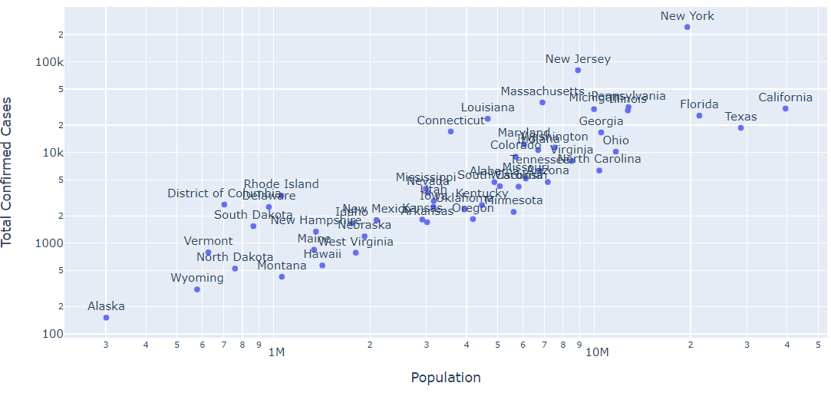
Exploratory Data Analysis
Relationship between population and total cases (log scale)
Notes:
Here’s a look at one of our data visualizations. In this scatter plot, we see that there is a strong a relationship between total confirmed cases of the virus and population in a region.
This motivated us to normalize the response variable of total confirmed cases by population so that it’s a population density.

Slide 6
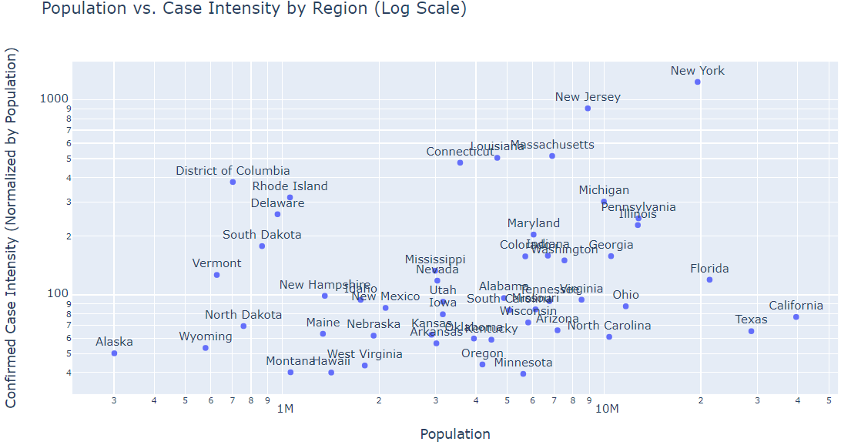
Exploratory Data Analysis
Relationship between population and case intensity (log scale)
“Case Intensity:”
Number of confirmed cases per 100,00 people
Notes:
When we normalized by population, we found that there is no longer a log-linear trend.

Slide 7
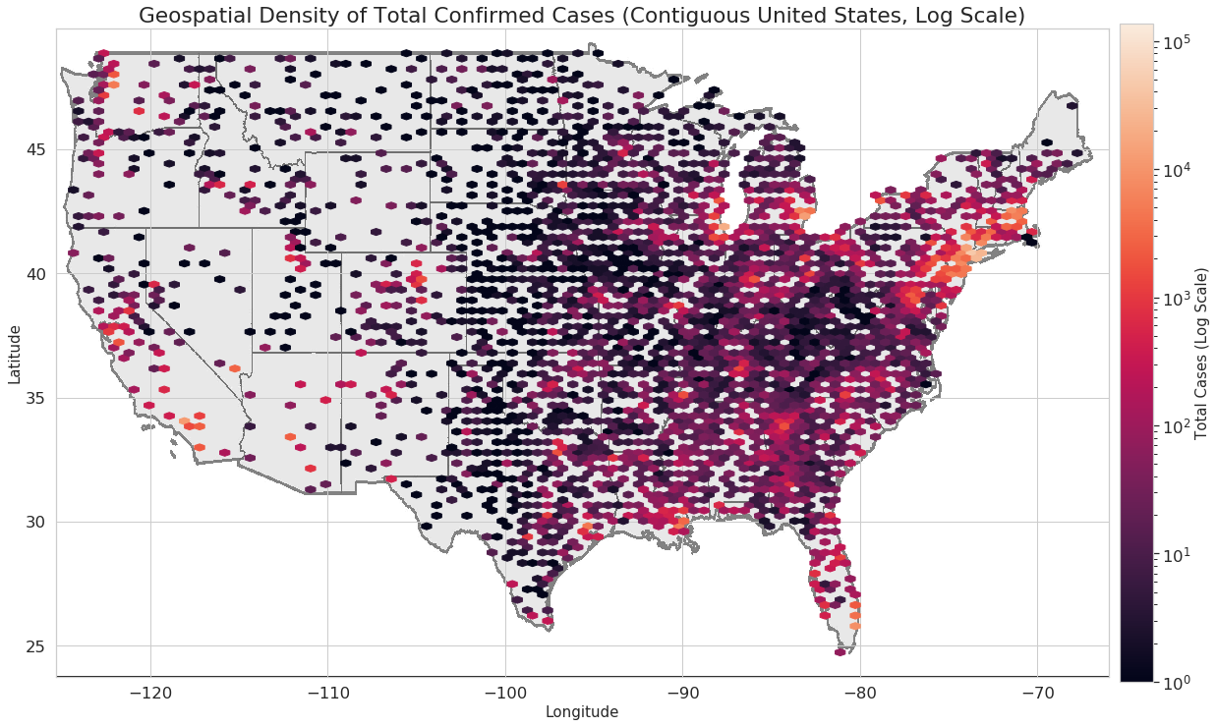
Exploratory Data Analysis
Notes:
In this visualization, we saw that the severity of COVID-19 cases are concentrated mainly in New York, and some other highly urbanized areas, motivating us to study urbanization and population density as some of our model features.

Slide 8
Methods and Experiments
Model Name | Features | Response Variable
Model B | Static Factors | Confirmed Case Intensity
Model F | Static Factors Stay-at-Home | Average Increase in Confirmed Case Intensity after Stay-at-Home
Model G | All Static Factors All Dynamic Factors | Weekly Proportional Increase In Confirmed Cases, compared to previous week
Notes:
When creating models to study our three project questions, we used Ridge regression, feature standardization, 90/10 train/test split, and k-fold cross validation with k = 5. The three models with best fit are shown here.
Each model compared different relationships between our factors of interest and the severity of COVID-19 spread in a region.
While the earlier models calculated increase in spread as an averaged rate before and after interventions, Model G took a look at the rate of spread on a weekly basis, allowing a more dynamic analysis of the response.

Slide 9
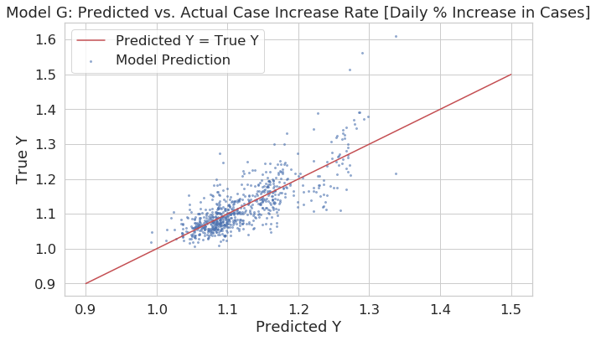
Results
The predictive model evaluating rate of spread achieved a much better prediction of response than the previous models.
Best features:
Stay-at-Home
Population Density
Limits on Social Gatherings
Notes:
In Model G, the predicted rate of spread matched quite well to the actual rate of spread, and best features included...
This shows that when predicting the true spread rate, it’s important to account for the dynamic factors, or the interventions implemented in each county, which in turn shows that they have a significant relationship with spread rate.

Slide 10
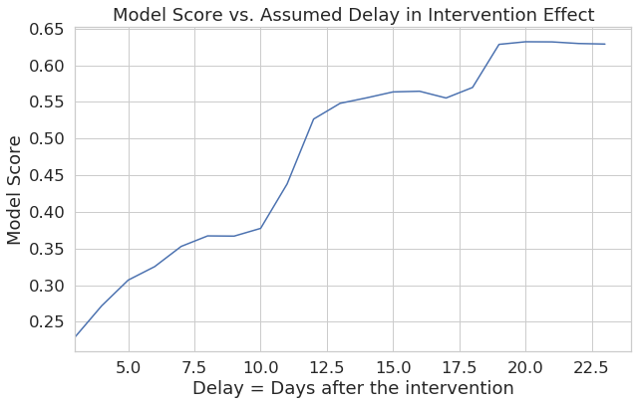
Results
From the predictive model, we infer that the time lag for full effectiveness of interventions is approximately 20 days.
Notes:
In the predictive model we were also able to evaluate the relative model fit based on different assumed delays between the implementation and effect of interventions.
From this model, the best model fit occurred with an assumed 20-day delay in intervention effect.

Slide 11
Results
The most important static features for predicting severity of COVID-19 spread are population density, disease mortality rates, and proportion of population which is elderly.
The stay-at-home order has a significant relationship with rate of spread
The dynamic model evaluating rate of spread by week achieved a much better prediction of response than the previous models.
Notes:
The results of our analysis showed us that 1, 2, and 3.

Slide 12
Results
Interesting findings:
Population proportion by gender in several age ranges were often in the top factors by weight, with older age groups having higher weights
Level of urbanization did not turn out to be a highly weighted factor in our models, although we expected it to relate strongly to the virus spread.
Important caveat:
Our results represent a lower bound estimate, due to the low proportion of testing and the resulting undercount of the true virus prevalence in the population.
Notes:
Some interesting finds from our study were that..
We note one of our important caveats from our analysis, which is that

